Slide 1
ANGULAR 7 FEATURES
V NAGA BALA TEJASWI
ID:5067565

Slide 2
OBJECTIVE:
Features of Angular 7
Animation
Material
Guards

Slide 3
What is Angular 7?
Angular is a framework to build a web application, which is becoming popular because of its unique features and ease to build an application. Angular 7 is an open source framework developed by Google. It completely relies on HTML and JavaScript. It converts a static HTML page into dynamic HTML page.

Slide 4
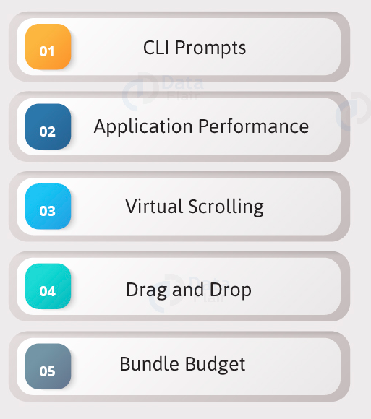
Features of Angular7…

Slide 5
1. CLI Prompts
It helps users to make a decision. It asks users about “want to add routing? Y/N” and about the type of styles user want to use.

Slide 6
Commads used in Angular7 projects…
Sr.No | Commands and Description
1 | Component ng g component new-component
2 | Directive ng g directive new-directive
3 | Pipe ng g pipe new-pipe
4 | Service ng g service new-service
5 | Module ng g module my-module
6 | Test ng test
7 | Build ng build --configuration=production // for production environment ng build --configuration=staging // for stating environment

Slide 7
2. Application Performance
Earlier reflect-metadata is used in production but it is required at the time of development. Therefore, ployfill.ts is removed by default in angular 7.

Slide 8
3. Virtual Scrolling
Google accelerates the speed of Angular 7 for a huge scrollable list.
Start with a plain Angular table
We’re starting with a pretty simple example of a table using a *ngFor loop

Slide 9

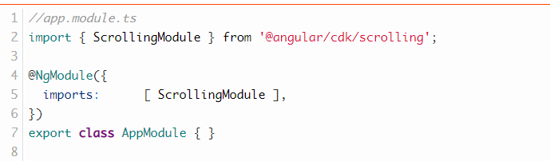
Introducing virtual scrolling
The Angular CDK provides a scrolling component. We’re now going to add it to our plain table in 4 simple steps.
1. Add the dependency
2. Add ScrollingModule

Slide 10
3. Add Scrolling Component
Step 2 is to add the <cdk-virtual-scroll-viewport> element around the markup of your table. We need to provide the attribute [itemSize]=”heightOfRowInPx” that tells the scrolling component how high each row is.
4. replace *ngFor with *cdkVirtualFor
instead of using *ngFor we’re going to use *cdkVirtualFor that is needed in order for the virtual scrolling to work as intended.

Slide 11
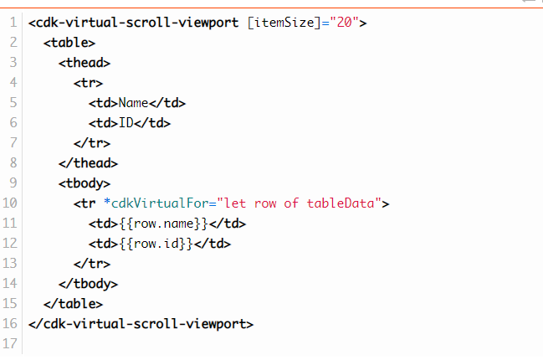

Slide 12
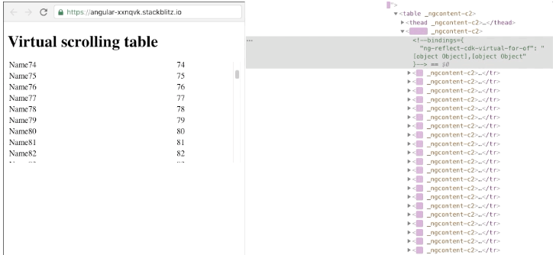
Result..
If we inspect the DOM changes after introducing the <cdk-virtual-scroll-viewport> we see that the browser is removing and adding DOM Nodes as we are scrolling.

Slide 13
4. Drag and Drop
It comes with the feature of automatic rendering.
5.Bundle Budget
If the bundle size is more than 2MB, a warning message provided and for above 5MB, an error will be given.

Slide 14
Animation
Animations add a lot of interaction between the html elements. Animation was available with Angular 2, from Angular 4 onwards animation is no more a part of the @angular/core library, but is a separate package that needs to be imported in app.module.ts.

Slide 15
To start with, we need to import the library with the below line of code

Slide 16
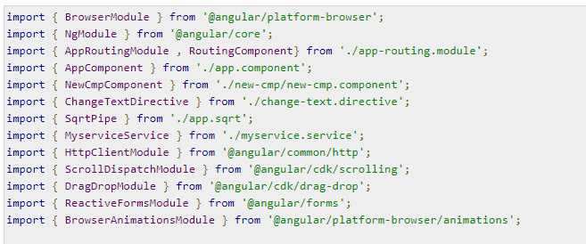
The BrowserAnimationsModule needs to be added to the import array in app.module.ts as shown below −

Slide 17
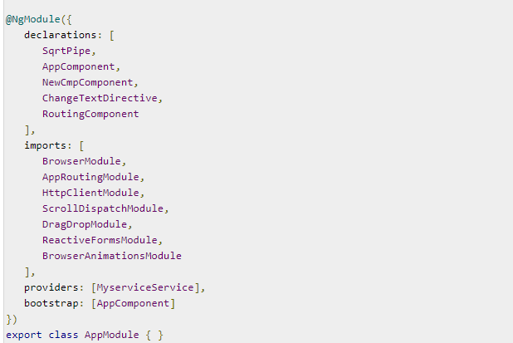

Slide 18
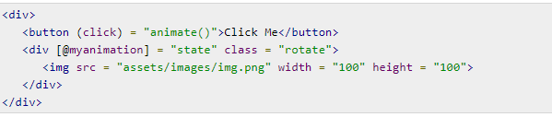
In app.component.html, we have added the html elements, which are to be animated.
Let us now see the app.component.ts where the animation is defined.

Slide 19
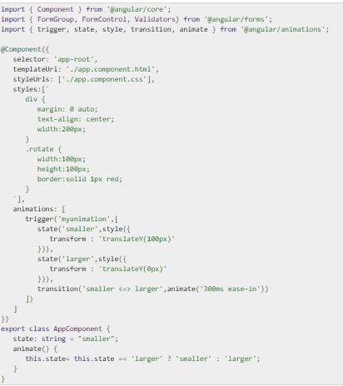

Slide 20
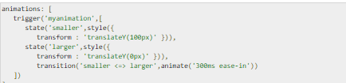
We have to import the animation function that is to be used in the .ts file as shown above.
Here we have imported trigger, state, style, transition, and animate from @angular/animations.
Now, we will add the animations property to the @Component () decorator −

Slide 21

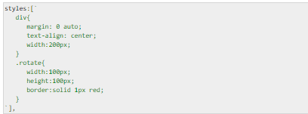
Let us now see the .html file to see how the transition function works −
There is a style property added in the @component directive, which centrally aligns the div. Let us consider the following example to understand the same −

Slide 22

Here, a special character [``] is used to add styles to the html element, if any. For the div, we have given the animation name defined in the app.component.ts file.
On the click of a button it calls the animate function, which is defined in the app.component.ts file as follows −

Slide 23
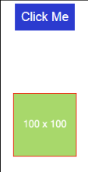
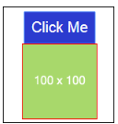
This is how the output in the browser (http://localhost:4200/) will look like −

Slide 24

Materials
Materials offer a lot of built-in modules for your project. Features such as autocomplete, datepicker, slider, menus, grids, and toolbar are available for use with materials in Angular 7.
To use materials, we need to import the package. Angular 2 also has all the above features but they are available as part of the @angular/core module. From Angular 4, Materials module has been made available with a separate module @angular/materials. This helps the user to import only the required materials in their project.
Following is the command to add materials to your project −

Slide 25
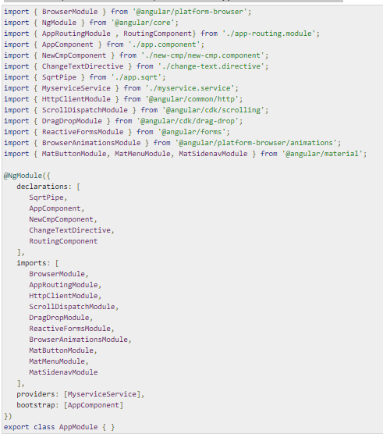
We will now import the modules in the parent module - app.module.ts as shown below.

Slide 26
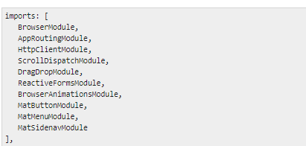
In the above file, we have imported the following modules from @angular/materials.
And the same is used in the imports array as shown below −

Slide 27
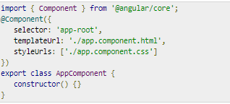
The app.component.ts is as shown below −
Let us now add the material-css support in styles.css.

Slide 28
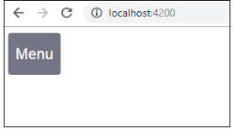
To add menu, <mat-menu></mat-menu> is used. The file and Save As items are added to the button under mat-menu. There is a main button added Menu. The reference of the same is given the <mat-menu> by using [matMenuTriggerFor]="menu" and using the menu with # in<mat-menu>.
The below image is displayed in the browser −

Slide 29
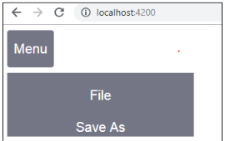

Slide 30
GUARDS
Guards in Angular are nothing but the functionality, logic, and code which are executed before the route is loaded or the ones leaving the route.
Different types of guards,
CanActivate guard (e.g. it checks route access).
CanActivateChild guard (checks child route access).
CanDeactivate guard (prompt for unsaved changes).
Resolve guard (pre-fetching route data).
CanLoad guard (check before loading feature module assets).

Slide 31
USE OF GUARD:
The Angular router's navigation guards allow to grant or remove access to certain parts of the navigation. Another route guard, the CanDeactivate guard, even allows you to prevent a user from accidentally leaving a component with unsaved changes.

